Slide 1
Section 9.2
The Law of Sines
Copyright © 2012 Pearson Education, Inc. Publishing as Prentice Hall.

Slide 2
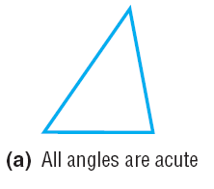
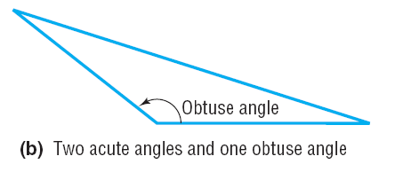
Copyright © 2012 Pearson Education, Inc. Publishing as Prentice Hall.

Slide 3
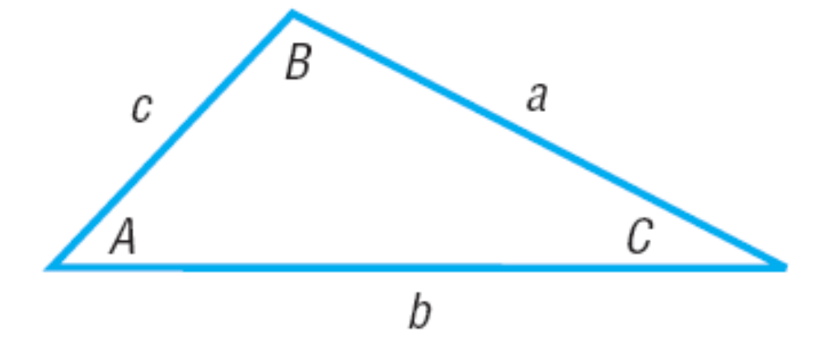
Oblique Triangle
(None of the angles is a right angle)
Copyright © 2012 Pearson Education, Inc. Publishing as Prentice Hall.

Slide 4
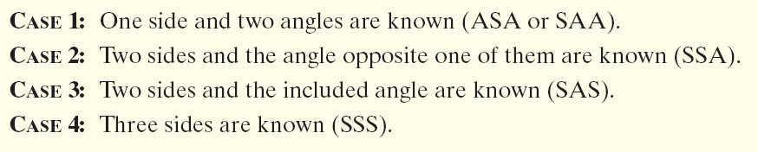
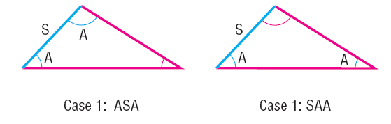
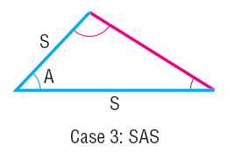
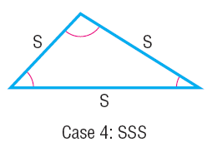
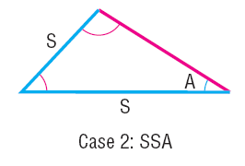
Copyright © 2012 Pearson Education, Inc. Publishing as Prentice Hall.

Slide 5

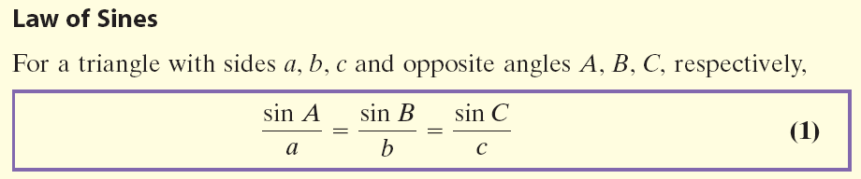
Copyright © 2012 Pearson Education, Inc. Publishing as Prentice Hall.

Slide 6
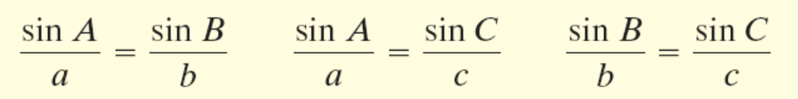

Copyright © 2012 Pearson Education, Inc. Publishing as Prentice Hall.

Slide 7

Copyright © 2012 Pearson Education, Inc. Publishing as Prentice Hall.

Slide 8




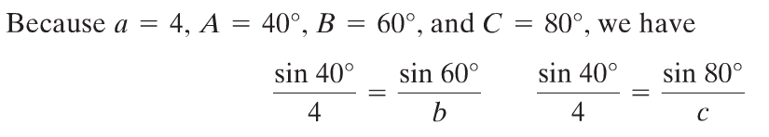
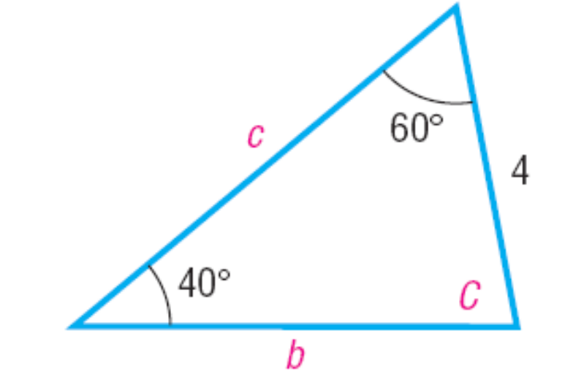


Copyright © 2012 Pearson Education, Inc. Publishing as Prentice Hall.

Slide 9


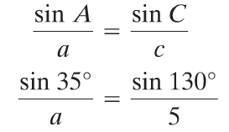

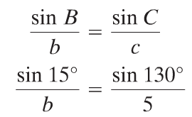
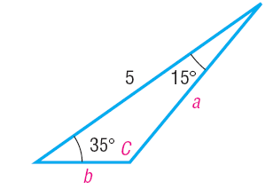

Copyright © 2012 Pearson Education, Inc. Publishing as Prentice Hall.

Slide 10

Copyright © 2012 Pearson Education, Inc. Publishing as Prentice Hall.

Slide 11
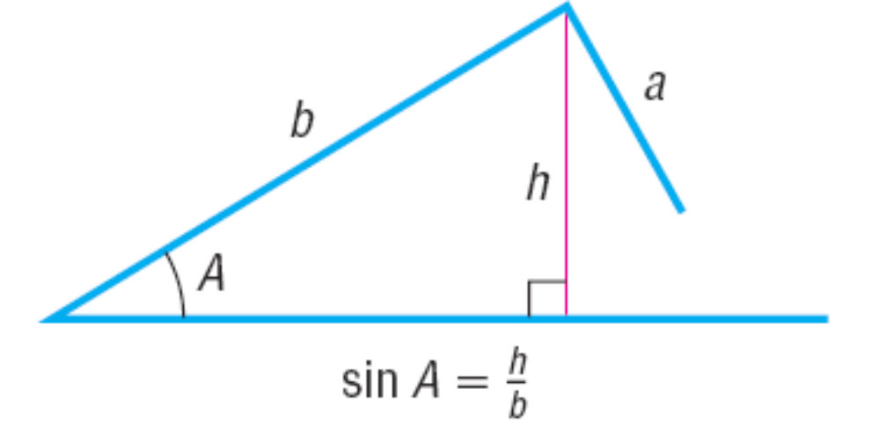
SSA --- The Ambiguous Case
Copyright © 2012 Pearson Education, Inc. Publishing as Prentice Hall.

Slide 12
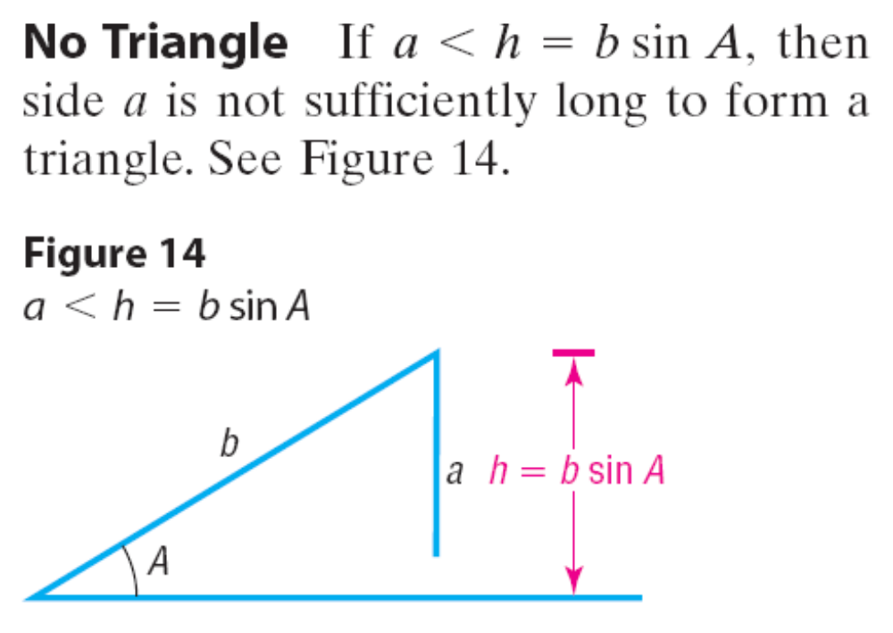
Copyright © 2012 Pearson Education, Inc. Publishing as Prentice Hall.

Slide 13
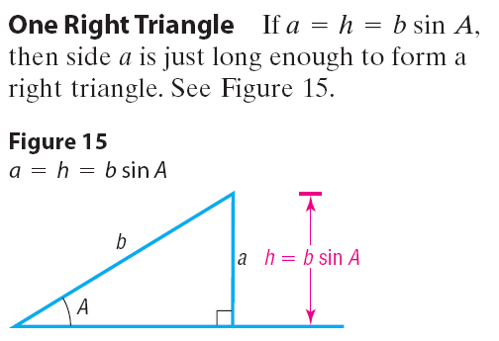
Copyright © 2012 Pearson Education, Inc. Publishing as Prentice Hall.

Slide 14
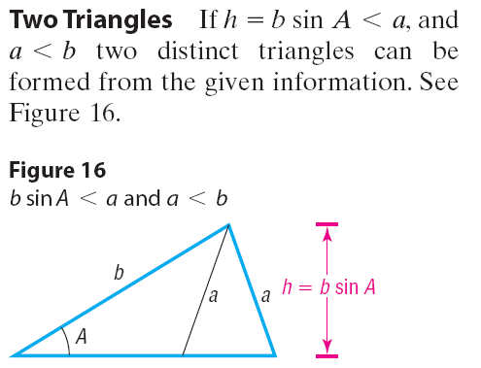
Copyright © 2012 Pearson Education, Inc. Publishing as Prentice Hall.

Slide 15
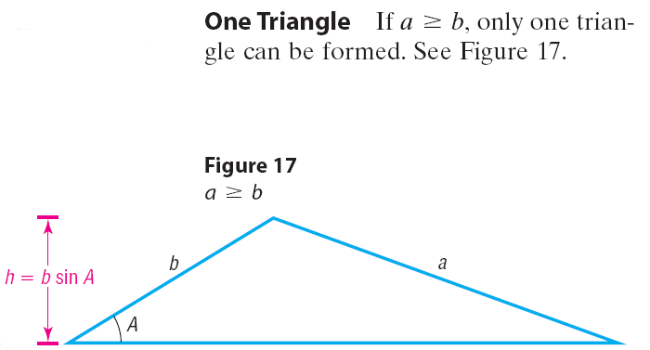
Copyright © 2012 Pearson Education, Inc. Publishing as Prentice Hall.

Slide 16


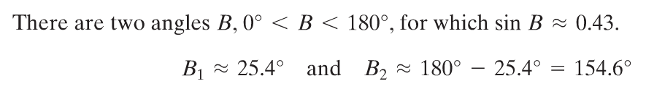
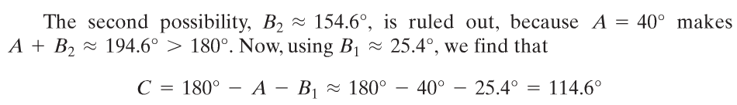


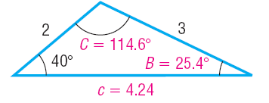
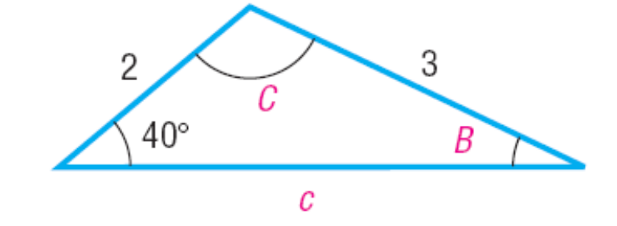
Copyright © 2012 Pearson Education, Inc. Publishing as Prentice Hall.

Slide 17

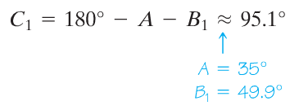



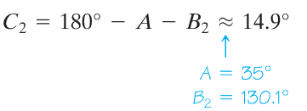


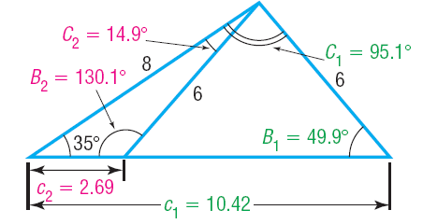
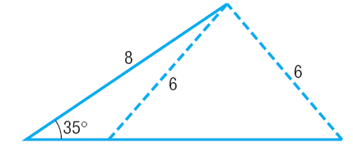
Copyright © 2012 Pearson Education, Inc. Publishing as Prentice Hall.

Slide 18


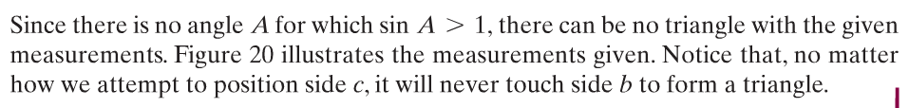
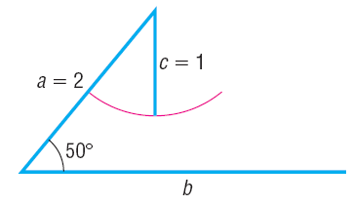
Copyright © 2012 Pearson Education, Inc. Publishing as Prentice Hall.

Slide 19

Copyright © 2012 Pearson Education, Inc. Publishing as Prentice Hall.

Slide 20
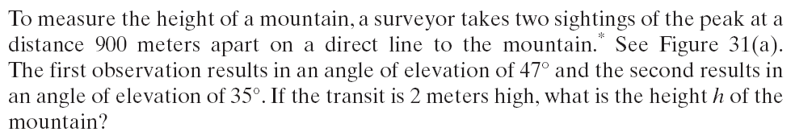
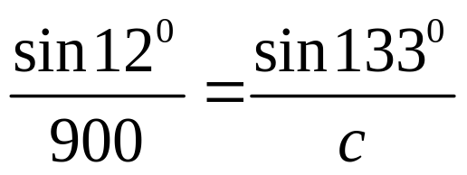






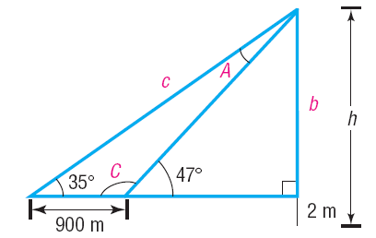
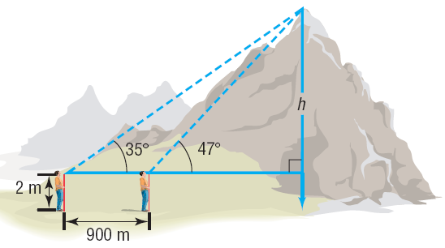


Copyright © 2012 Pearson Education, Inc. Publishing as Prentice Hall.

Slide 21

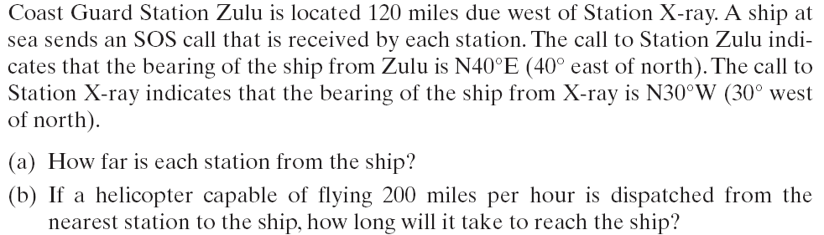
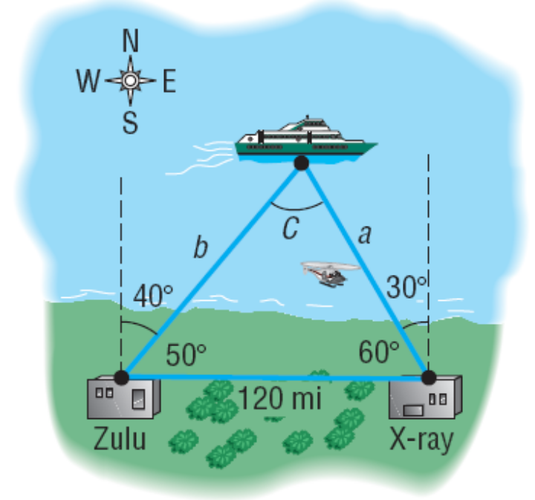



Copyright © 2012 Pearson Education, Inc. Publishing as Prentice Hall.

Slide 22


Copyright © 2012 Pearson Education, Inc. Publishing as Prentice Hall.

Slide 23
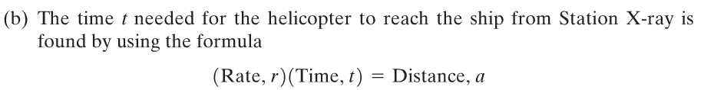

It will take about 29 minutes for the helicopter to reach the ship.
Copyright © 2012 Pearson Education, Inc. Publishing as Prentice Hall.

Slide 24

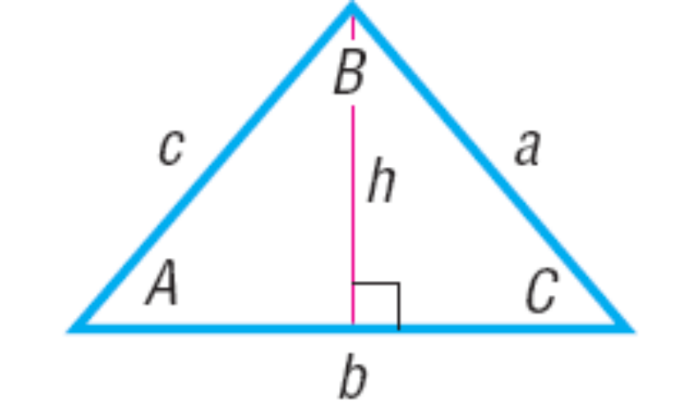
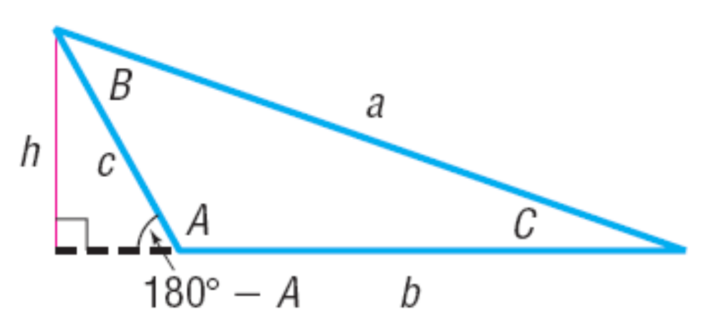
Copyright © 2012 Pearson Education, Inc. Publishing as Prentice Hall.

Slide 25
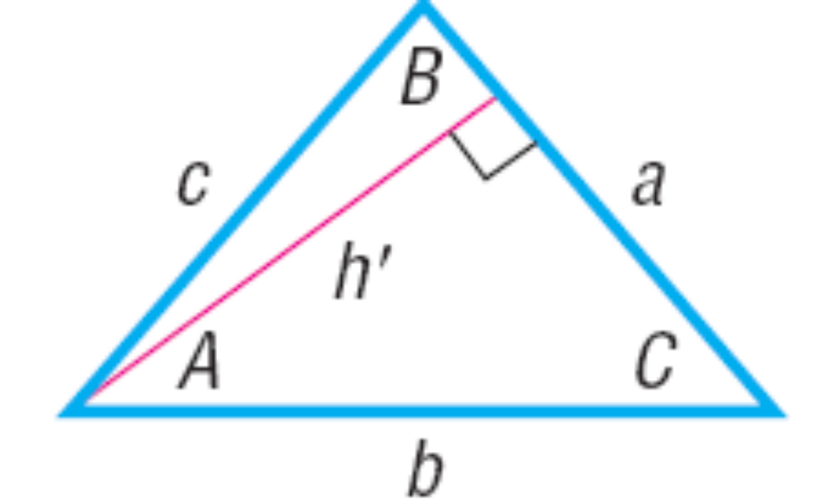
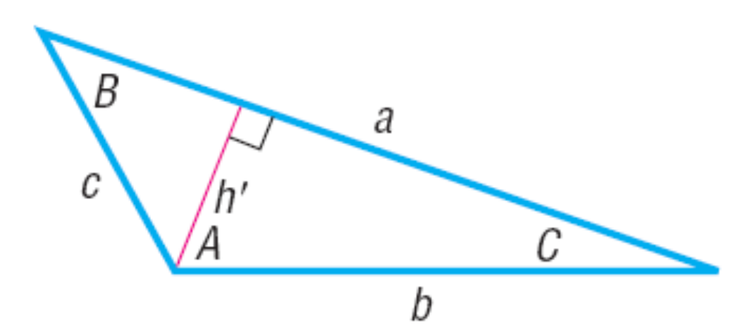
Copyright © 2012 Pearson Education, Inc. Publishing as Prentice Hall.

